Slide 1
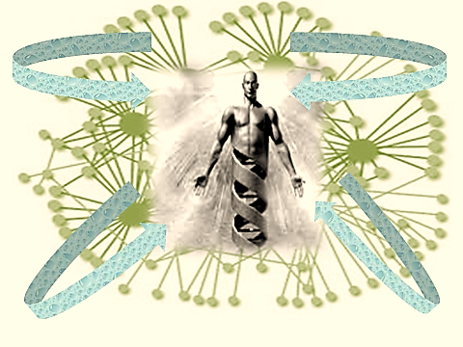
THE SCIENCE OF PHILOSOPHY.

Slide 2
From all intellectual disciplines, there exists a scholarly Philosophical version like the philosophy of Language, Art, Humor, the Mind, History ... and SCIENCE.
Why not a SCIENCE of PHILOSOPHY?
Brentano and Husserl are philosophers that at least recognized the issue.
“The true method of philosophy is none other than that of the natural sciences.” (Brentano ).
“ Philosophy can be a rigorous science only if it succeeds in developing and applying a very own method that is distinct from and prior to that of the natural sciences.” (Husserl).

Slide 3
Some definitions / descriptions on Philosophy.
PHILOSOPHY is the study of Knowledge, of thinking about thinking. — the most simple definition.
PHILOSPHY meets SCIENCE in METAPHYSICS.
PHILOSOPHY is intellectual thought on what lies beyond Time, Space, and Causation, by those without direct, first hand knowledge.
METAPHYSICS is Philosophy of direct experience beyond Time, Space and Causation, by those that bring the information directly from beyond.
― this is a grab from the many definitions.

Slide 4
Brentano’s start focus is on - intentionality – the key constituent of mental states
– To be conscious you must be conscious of something
– To think you must think about something
– The “something” is named “the intentional object of consciousness”
– Hence, the mind is mobile or dynamic, not static as per any theory of correspondence.
– Consciousness points to the objects of consciousness (they come from elsewhere), while Kant claims that we construct the objects of consciousness.
Husserl: CONSCIOUSNESS is the main topic for philosophy.

Slide 5
When SCIENCE can explain CONSCIOUSNESS, then all Philosophies of x, y, z should explain their subjects in what is known about Consciousness.
Science’s focus on Consciousness is mainly in NEUROSCIENCE.
Neuroscience needs support from other sciences like System and Complexity, Chaos Theory, Wave functions, Evolution, Fourier transformation, Big Data and self regulating systems, Holography, and many more.

Slide 6
Some statements on CONSCIOUSNESS.
At least all philosophers agree that we can define Reality as a System being a construct of relations with many dimensions that vary in time.
Reality, as a relational system, seeks stable and consistent patterns recognizable by the brain maps in storage. The process does not differentiate whether the input is real or mentally fabricated. From this broad perspective, we consider Augmented Reality as a tool that enhances communication.
The conscious of the Conscious is a milestone in the Evolution.
The only laws of matter are those fabricated by our Mind, and the laws of the mind are fabricated by matter. James Maxwell.

Slide 7
The sapiens fill their imagined concepts with mental content via a ritual called Logic.
Life is a super complexity of coupled rhythmic transformation of content and shape, which promotes ‘being’ to a Ritual. The bodily ritual is completed with a similar mental rhythm with spirits, mood, longing, love, anger, hope, wu-wei, and many more.
Your body is the inverse Fourier function of all live organic stages.
Our organic body is the MIRROR of EVOLUTION, TIME, and RHYTHM.

Slide 8
“ If we think in relations, and if relations have some universal form, it is manifest that such universal forms of relations become universal forms of consciousness”. Herbert Spencer.
Cogito or cogitations comprise all the acts of consciousness. Husserl.

Slide 9
Physical statements.
The scientists come close to a physical description of Consciousness.
The BRAIN organ mirrors the Evolution physically in the network of neurons, the connectome, the cell DNA, and the semiotic code, which regulates the system communication.
The MIND is the continuous rehearsal of the story of Evolution and the personal physical and mental experience updated until now.

Slide 10
Consciousness is understood as a microscopic neural ordered switching of patterns which result from the microscopic interaction of elements from the brain.
Consciousness is a state in which several sensory stimuli and mental functions are integrated in a few seconds and standing in the focus of one’s attention. Klaus Mainzer.
Rhythm is what connects the most elementary and primitive bodily structures of even the most simple organism to the implacable movements of the universe itself: art, music, sculpture, painting, architecture, dance, resonates or transmits force through every structure . Elisabeth Grosz, Chaos, Territory, Art. 2008.

Slide 11
The perception of our senses is simply a set of Fourier processes. In the hearing process, organic mechanisms tune the pressure frequencies from the air, followed by Fourier analysis and reverse Fourier calculations to create an image.
The Conscious is a series of moments where the brain's mental stage reaches criticality and sets off to a next now point of choice.
Our life functions and the awareness and knowledge of it are the Inverse Fourier of the whole past.
A key notion is the concept of “time – frequency”.
The Time-Space based Reality is replaced by moments, relations (coupled vibrators) and waves.

Slide 12
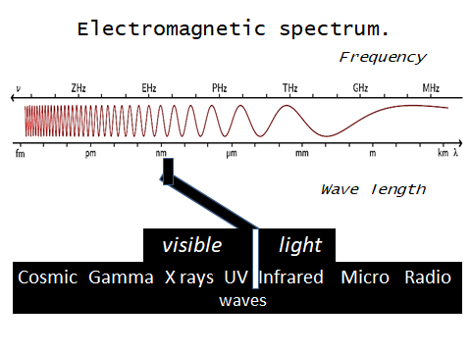
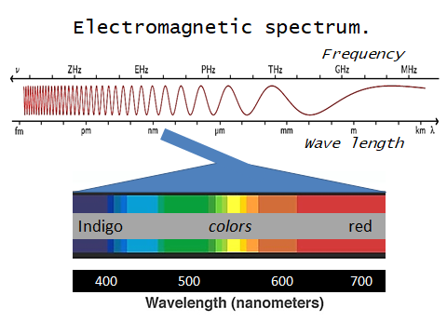
All cognition ultimately refers back to our senses that process data from electro-magnetic waves.
All knowledge and models from the Universe to DNA molecules and atoms is interpretations of phenomenon related to waves.

Slide 13
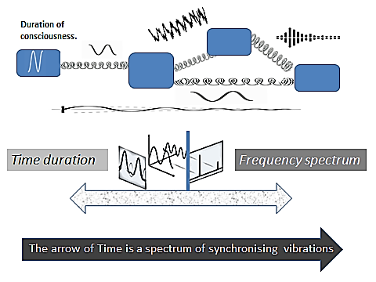
The ultra dense data processing of the brain is a holographic process of coupled vibrators.

Slide 14
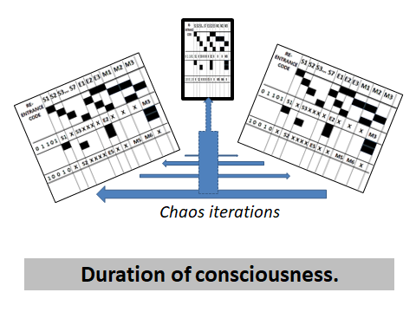
CONSCIOUSNESS is the awareness the processing of Relational data sets.
The awareness of differences in brain maps triggers an iterative brain routine to come up with a stable pattern. That process generates awareness and has a duration. Consciousness is a continuum of successive durations. We call this also a NOW point or a moment. There is no longer a flowing time. The content of the brain maps is the cumulative experience and cognition available at that moment.

Slide 15
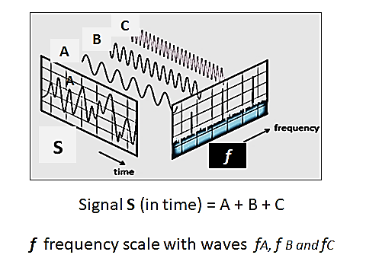
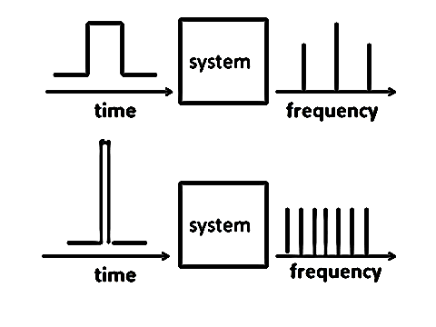
Reality is no longer a sensation of Time and Space but
a DURATION and FREQUENCY SPECTRUM of events.
Example: the Big Bang as a Time duration presents a reality of all possible repetitive events.

Slide 16
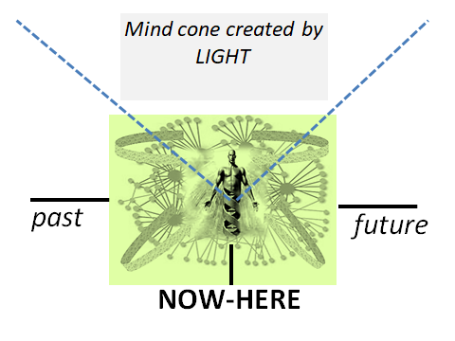
The new mode of Reality

Slide 17
Read/download
the whole story.
The Mirror Brain-Mind.
Neuroscience and Philosophy.
By Ronny Verlet
https://www.scribd.com/document/457130751/The-Mirror-Brain-Mind-2020
https://archive.org/details/the-mirror-brain-mind.-2020./mode/2up

Slide 18
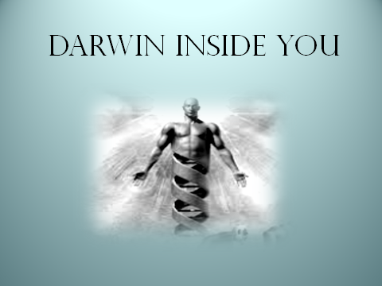
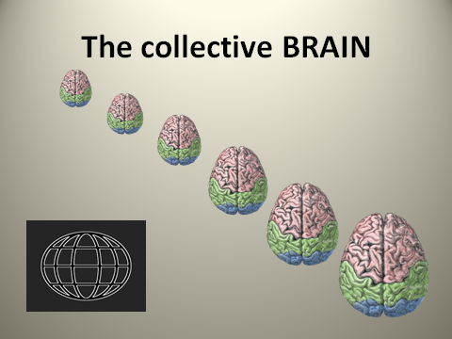
Other talks to the defunct philosophers.
https://www.slideshare.net/RonnyVerlet/evolution-now
https://www.slideshare.net/RonnyVerlet/brain-energy-232288799

